Slide 1
Regular Expressions
COP 4020
Pete Dobbins

Slide 2
Definitions
Used to specify simple sets of strings
Possibly infinite
Use Cases:
To specify lexical structure of programming languages
grep
Unix shell file lists for commands
Context search in editors
Scripting language such as JavaScript, Perl, and Python
Try some out in this analyzer: https://regexper.com/

Slide 3
Definitions
Atom
Concatenation
Alternative
Kleene Closure
Positive Closure
Blocking
Meta Symbols | Additional Operations
Restrictions | Limitations

Slide 4
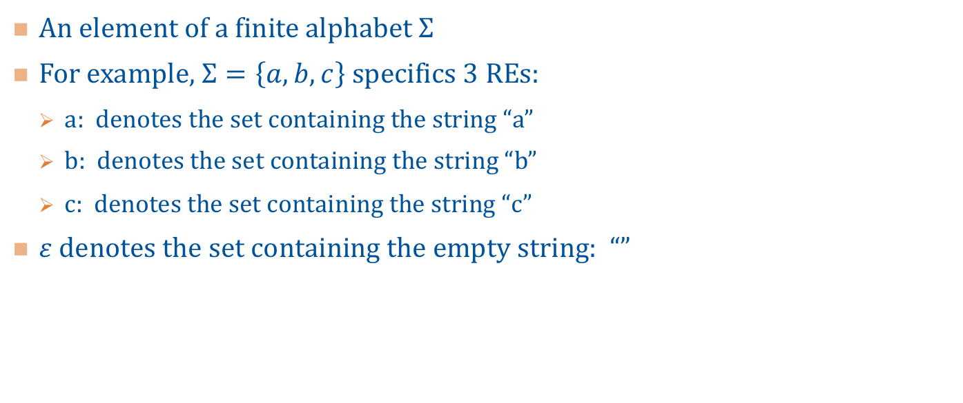
Definitions: Atom
An element of a finite alphabet $Σ$
For example, $Σ=\left\{a,b,c\right\}$ specifics 3 REs:
a: denotes the set containing the string “a”
b: denotes the set containing the string “b”
c: denotes the set containing the string “c”
$ε$ denotes the set containing the empty string: “”

Slide 5
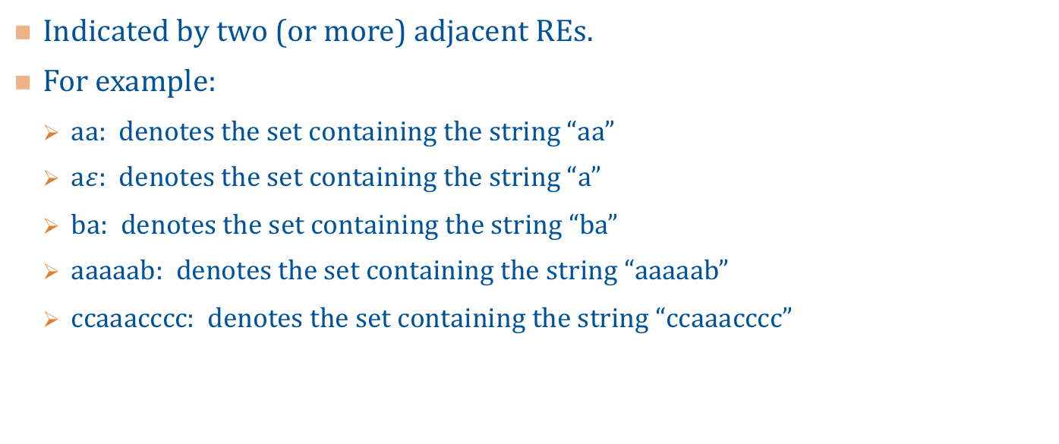
Definitions: Concatenation
Indicated by two (or more) adjacent REs.
For example:
aa: denotes the set containing the string “aa”
a$ε$: denotes the set containing the string “a”
ba: denotes the set containing the string “ba”
aaaaab: denotes the set containing the string “aaaaab”
ccaaacccc: denotes the set containing the string “ccaaacccc”

Slide 6
Definitions: Alternative (Disjunction), |
Denotes the union of the sets denoted by the two REs separated by |
For example:
a|b: denotes the set of strings { “a”, “b” }
a|ab|abc: denotes the set of strings { “a”, “ab”, “abc” }
(a|b)c: denotes the set containing the strings { “ac”, “bc” }
Note, the parenthesis define the set a or b, followed by c

Slide 7
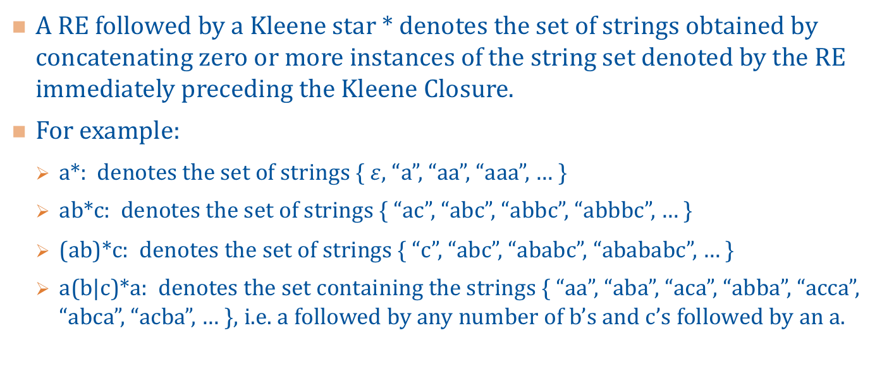
Definitions: Kleene Closure, *
A RE followed by a Kleene star * denotes the set of strings obtained by concatenating zero or more instances of the string set denoted by the RE immediately preceding the Kleene Closure.
For example:
a*: denotes the set of strings { $ε$, “a”, “aa”, “aaa”, … }
ab*c: denotes the set of strings { “ac”, “abc”, “abbc”, “abbbc”, … }
(ab)*c: denotes the set of strings { “c”, “abc”, “ababc”, “abababc”, … }
a(b|c)*a: denotes the set containing the strings { “aa”, “aba”, “aca”, “abba”, “acca”, “abca”, “acba”, … }, i.e. a followed by any number of b’s and c’s followed by an a.

Slide 8
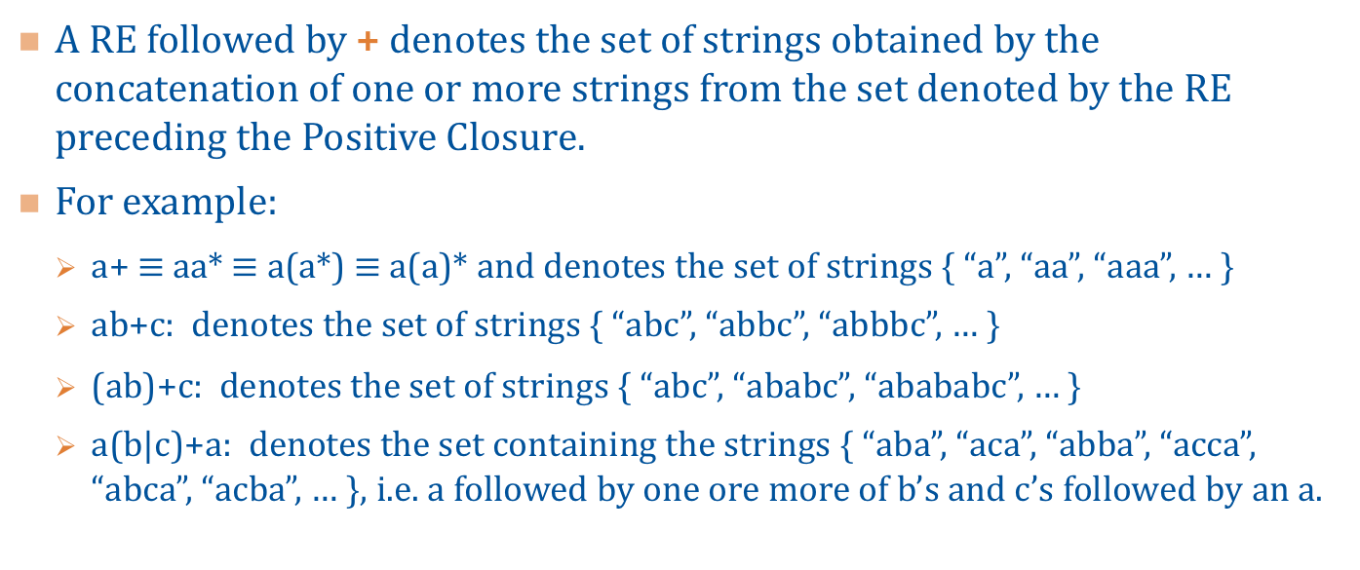
Definitions: Positive Closure, +
A RE followed by + denotes the set of strings obtained by the concatenation of one or more strings from the set denoted by the RE preceding the Positive Closure.
For example:
a+ $≡$ aa* $≡$ a(a*) $≡$ a(a)* and denotes the set of strings { “a”, “aa”, “aaa”, … }
ab+c: denotes the set of strings { “abc”, “abbc”, “abbbc”, … }
(ab)+c: denotes the set of strings { “abc”, “ababc”, “abababc”, … }
a(b|c)+a: denotes the set containing the strings { “aba”, “aca”, “abba”, “acca”, “abca”, “acba”, … }, i.e. a followed by one ore more of b’s and c’s followed by an a.

Slide 9
Definitions: Blocking
Symbol | Description
() | Blocks off or groups a RE
[] | Match on one of whatever is in []s
{n} | denotes n occurrences of preceding RE
{n,} | denotes n+ occurrences of preceding RE
{,n} | denotes at most n occurrences of preceding RE (not universal)
{m,n} | denotes at least m and at most n occurrences of preceding RE
[a–d] | denotes alphabetic range: a through d
[1–3] | denotes numeric range: 1 through 3

Slide 10
Definitions: Meta Symbols
Symbol | Description
| | Alternative (disjunction)
* | Kleene Closure
+ | Positive Closure
? | Zero or one of preceding
^ | Match at start | left side of string, RE follows ^: ^abc
^ | Within []s negates RE: [^abc]
$ | Match at end | right side of string, RE precedes $: abc$
. | Matches all single characters other than newline
\ | Escape Sequence

Slide 11
Definitions: Escaping Meta Symbols
Symbol | Description
\\ | The literal backslash
\* | The literal asterisk
\+ | The literal plus sign
\? | The literal question mark
\^ | The literal caret
$ | The literal dollar sign
. | The literal period
\[ | The literal open straight bracket, and so on for: ], (, ), etc
\n | The literal newline and so on for: \t, \

Slide 12
Definitions: Escaping
Symbol | Description
\# | Back references the group # from preceding ()s from left to right
\b | Single word boundary
\d | Single digit
\D | Single non-digit
\w | Single word character (alphanumeric and the underscore)
\W | Single non-word character
\s | Single whitespace character
\S | Single non-whitespace character

Slide 13
Restrictions | Limitations
REs cannot contain recursive definitions: although some expressions may be defined in terms of others, nothing is defined (directly or indirectly) in terms of itself.
Lack of recursion limits the expressiveness of the language (set of strings) that can be specified.
For example:
We cannot specify nested constructs such as the set of strings with balanced parentheses using a RE.
We cannot specify nested comments such as /* /* … */ */ in some languages.

Slide 14
Recognizing Tokens
REs specify or generate tokens.
We need to recognize tokens.
A Deterministic Finite Automaton (DFA|DFSM) is used to recognize the language that can be generated by a given RE.
We call this part of compilation Lexical Analysis.
The interpreter | compiler component that performs lexical analysis is called a Scanner or Lexer.

